Slide 1
Achievements
2026

Slide 2
Inter school achievements

Slide 3
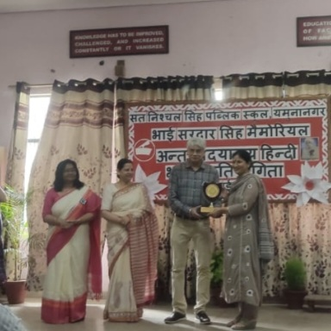
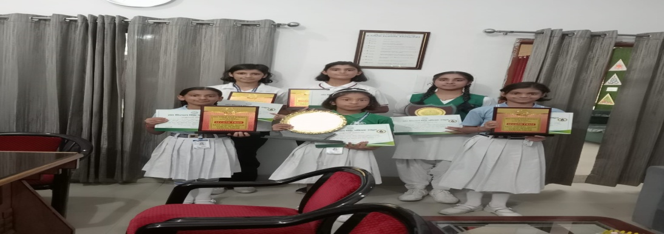
Hindi Declamation competition held at Sant Nischal Singh Public School, YamunaNagar.
Hindi Declamation competition was conducted on 25th July 2025 at Sant Nischal Singh Public School, Yamuna Nagar. Students of Dyal Singh Public School, Jagadhri participated in the competition with great zeal and brought laurels to the school by bagging Running Trophy in Group 2 and Group 3.
Results are as follows: -
Group 1-Seerat of 5th Tagore secured 2nd position.
Group 2- Kanchan of class 7th Nehru and Advitti of class 8th Nehru secured 2nd position.
Group 3- Vidhisha of class IX secured 2nd position and Samridhi of class IX got consolation prize. It was a proud moment for the school.

Slide 4
YOGA COMPETITION (GIRLS)
YOGA COMPETITION (BOYS)
District Level Yoga Championship for girls was held at Guru Nanak Girls College, Yamuna Nagar on 19th July 2025. The results are as follows:-
Under 8 Years Ananya ( Silver Medal), Mansirat Kaur –( Bronze Medal) , Arshdeep Kaur – (Bronze Medal)
8 to 10 Years: Shivanshi – (Gold Medal) ,Naman –( Silver Medal)
10 to 12 Years: Vaishnavi (Gold Medal),Harika (Silver Medal), Gargi( Bronze Medal)
12 to 14 Years: Ananya( Bronze Medal),Tanishka ( Bronze Medal)
14 to 16 Years: Jashanpreet( Silver Medal)
16 to 18 Years: Yamini (Silver Medal)
Following students were selected for the State Level Yoga Championship!
Vaishnavi (VI N) Harika (VG ) Naman ( V S) Ananya (7N)
Shivanshi (IV N) Jashanpreet (X ) Yamini (XI )
District level Yoga Championship (Boys) was held on 20th July 2025 at New Happy Public School Yamuna Nagar.
Results are as follows:-
Parv – Gold Medal (Under 8 years) ,Devank – Bronze Medal (8 to 10 years)
Jaskaran Singh – Bronze Medal (8 to 10 years) ,Udit – Bronze Medal (8 to 10 years)
Aarohan – Bronze Medal (10 to 12 years), Abhay – Bronze Medal (12 to 14 years) Alish – Bronze Medal (12 to 14 years) , Jayant – Bronze Medal (14 to 16 years)

Slide 5
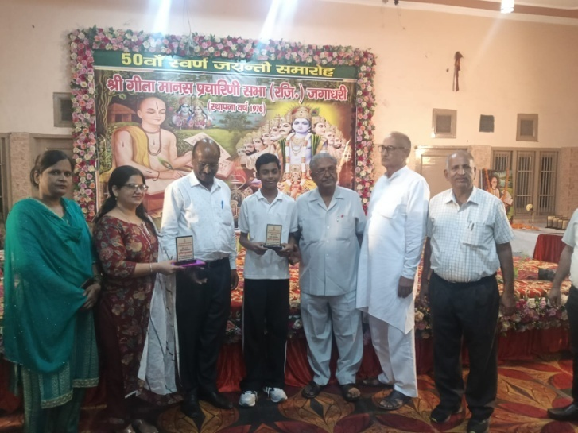
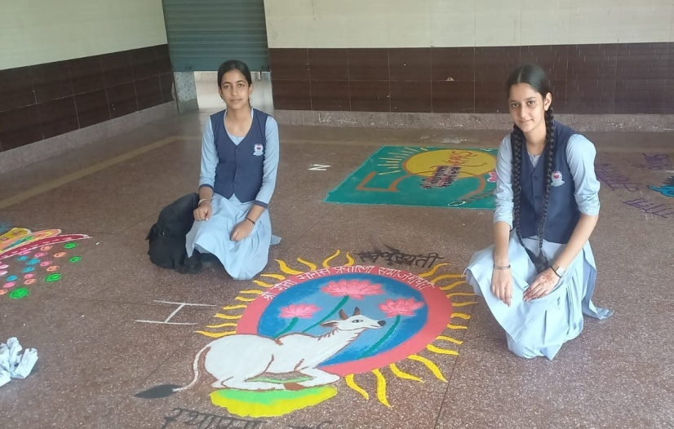
TULSI DAS JAYANTI SAMAROH
On the occasion of Tulsi Das Jayanti different Inter School Competitions were held on 30th July 25 at Ram Leela Bhawan, Jagadhri in which the students from various classes took active part and added feathers to the school's cap by winning prizes.
Following are the results:-
Painting-Sanvi of Class 7th Subhash got 1st prize and Aayush of class IX got 3rd prize. In Colouring – Hansika of class V Nehru got Consolation prize .
Rangoli-Kanan and Karanjot of class XI got 3rd prize.

Slide 6
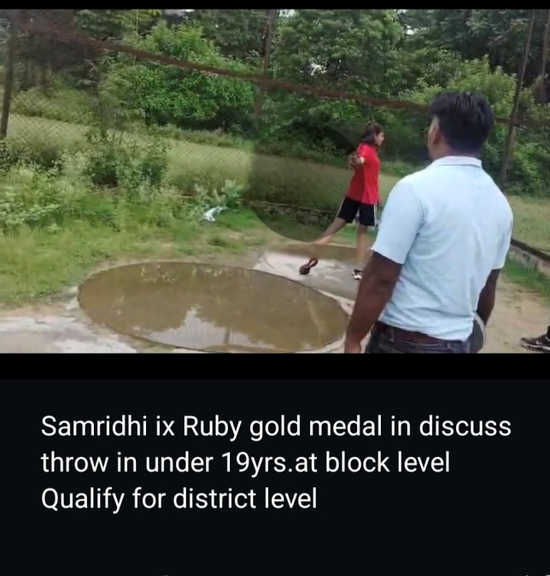
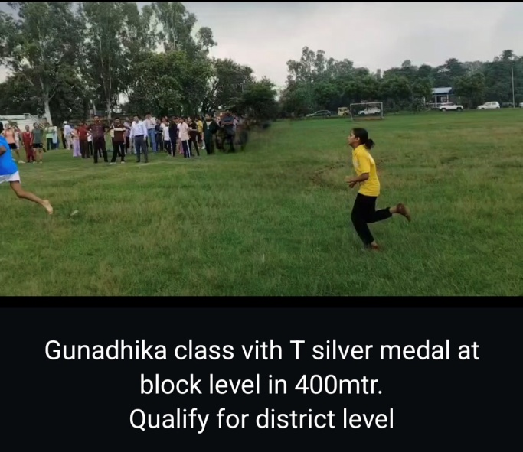
Block level Athletics Competition
Athletics competition was a thrilling track and field event highlighting athletes’ ability. Girls’ athletics team of Dyal Singh Public school, Jagadhri delivered an outstanding performance at the block level athletics competition held at Tejli Sports Complex Yamuna Nagar on 31st July 2025.
The event was a testament to the athletes hard work and dedication. As they brought laurels to the school by winning medals and getting selected for The District Level Athletics Competition to be held in near future.
Results are as follows:-
1. Samridhi (IX Ruby) – Gold Medal in Discus Throw (Under 19 years)
2. Samridhi (IX Ruby) – Gold Medal in 400m Race (Under 19 years)
3. Samridhi (IX Ruby) – Bronze Medal in 100m Race (Under 19 years)
4. Gunadhika (VI Tagore) – Silver Medal in 400m Race (Under 14 years)
5. Gunadhika (VI Tagore) – Silver Medal in High Jump (Under 14 years)
6. Agamjot Kaur (VI Tagore) – Bronze Medal in High Jump (Under 14 years)

Slide 7
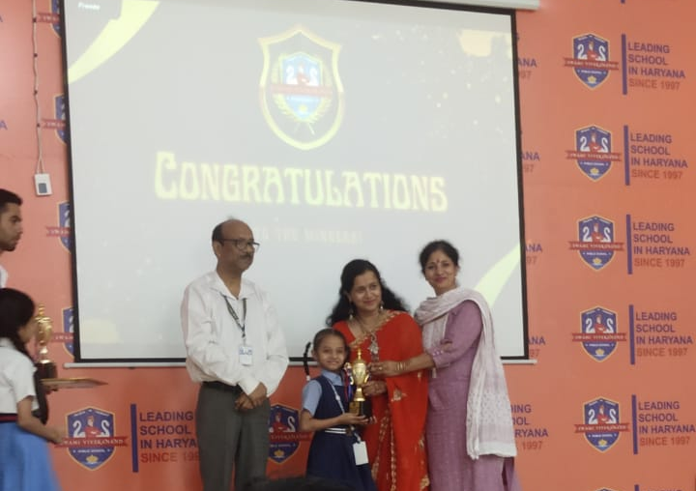
Inter School Literary Events held at Swami Vivekanand Public School
Amaira of Grade 3 participated in Hindi Poetry Competition on 14th October, 2025 and bagged 1st Position.

Slide 8
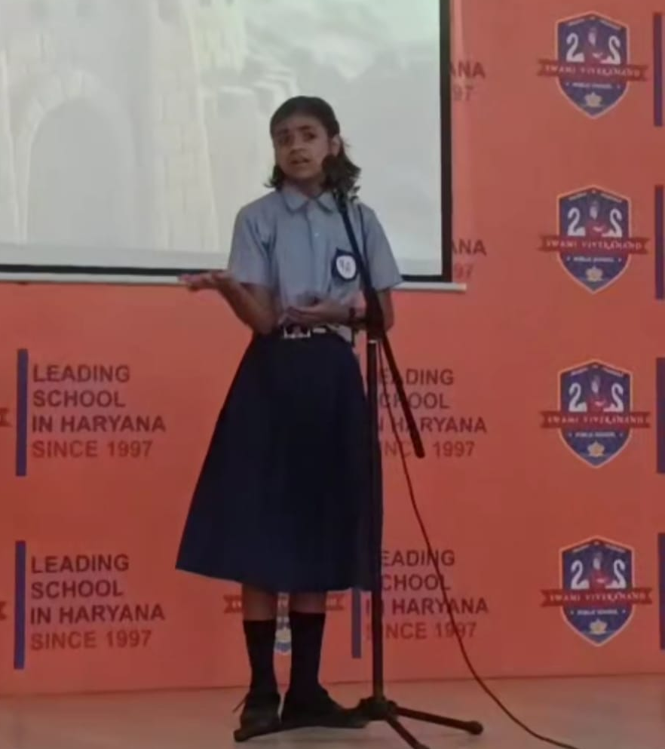
Inter School Literary Events held at Swami Vivekanand Public School
Kanchan of Grade 6 participated in English Poetry Competition on 13th October, 2025 and bagged 3rd Position.

Slide 9
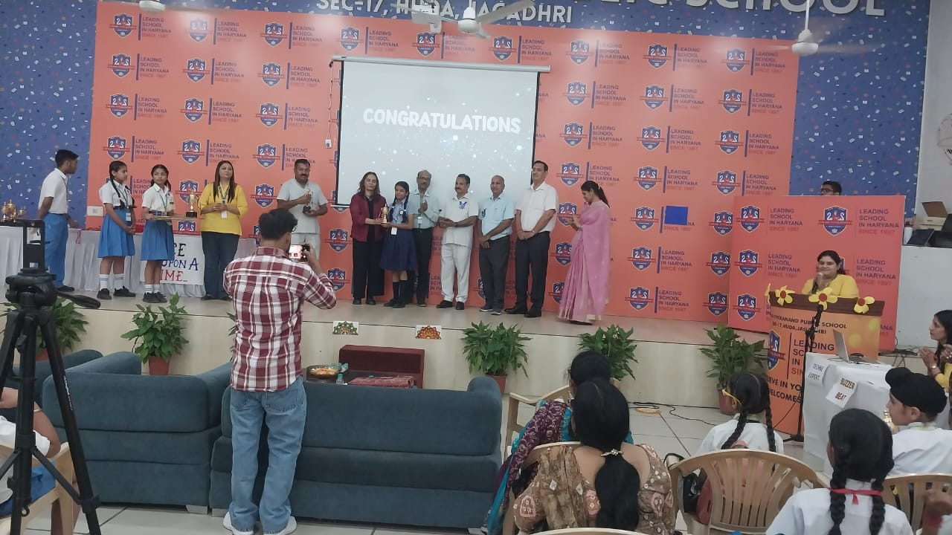
Inter School Literary Events held at Swami Vivekanand Public School
Jiya of Grade 5 participated in Hindi Story telling Competition on 15th October, 2025 and bagged 3rd Position.

Slide 10
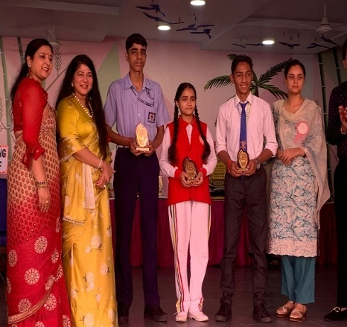
Drawing and Painting Competition held at Anand Public School
Harshwardhan of Grade 9 participated in Poster Making Competition on 8th October, 2025 and bagged 2nd Position.

Slide 11
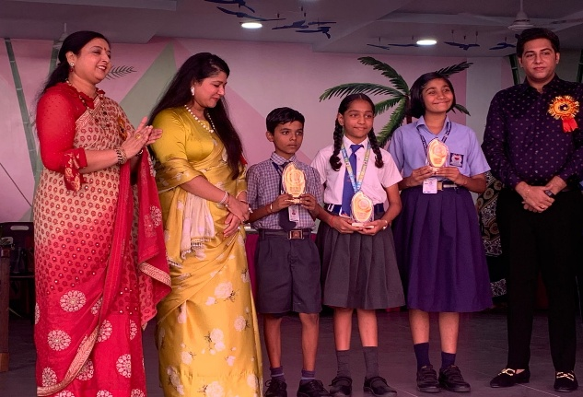
Drawing and Painting Competition held at Anand Public School
Hansika of Grade 5 participated in Painting Competition on 8th October, 2025 and bagged 3rd Position.

Slide 12
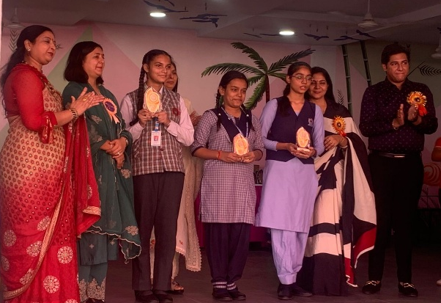
Drawing and Painting Competition held at Anand Public School
Akshara of Grade 12 participated in Collage making Competition on 8th October, 2025 and bagged 3rd Position.

Slide 13
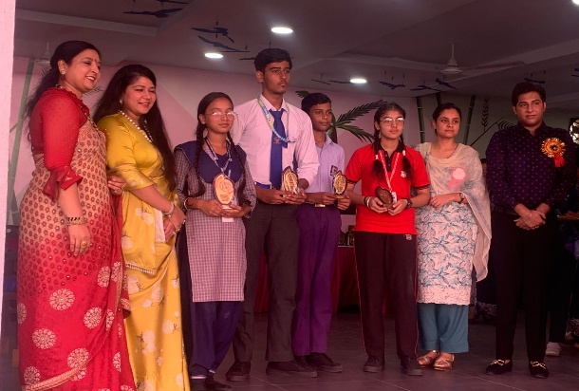
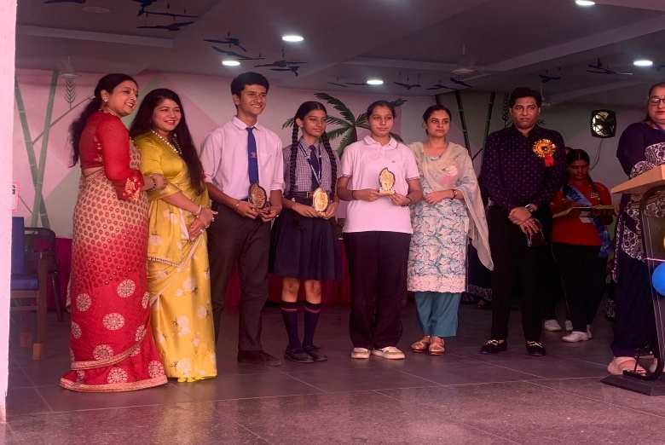
Drawing and Painting Competition held at Anand Public School
Aayush and Devanshi of Grade 9 participated in Rangoli Competition on 8th October, 2025 and bagged 3rd Position.

Slide 14
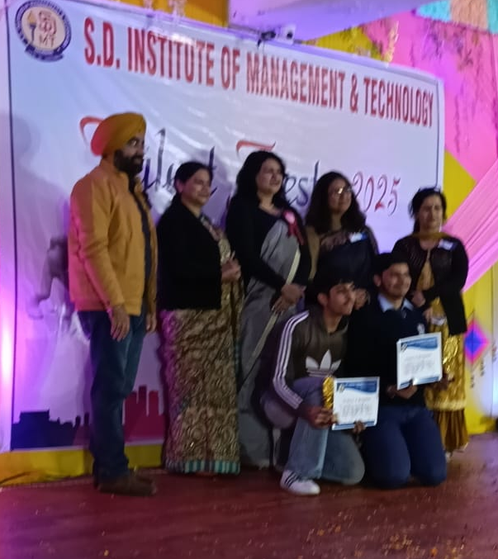
INTER SCHOOL ART & CRAFT COMPETITION
An inter -School Art & Craft Competition was held at S.D. Institute of Management, Yamuna Nagar. Our students Manikya (12 Humanities) and Aayan Bakshi (11 Commerce) participated in Best Out of Waste competition and won 1st Prize.

Slide 15
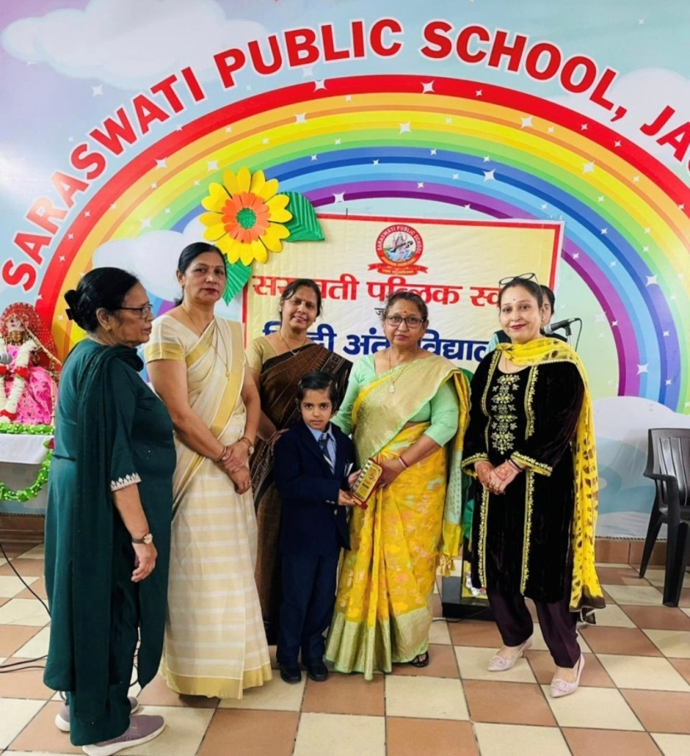
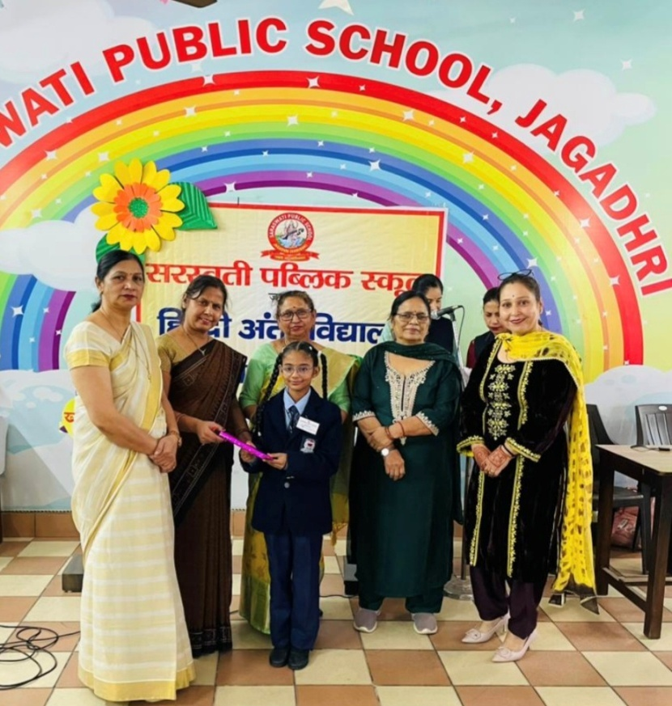
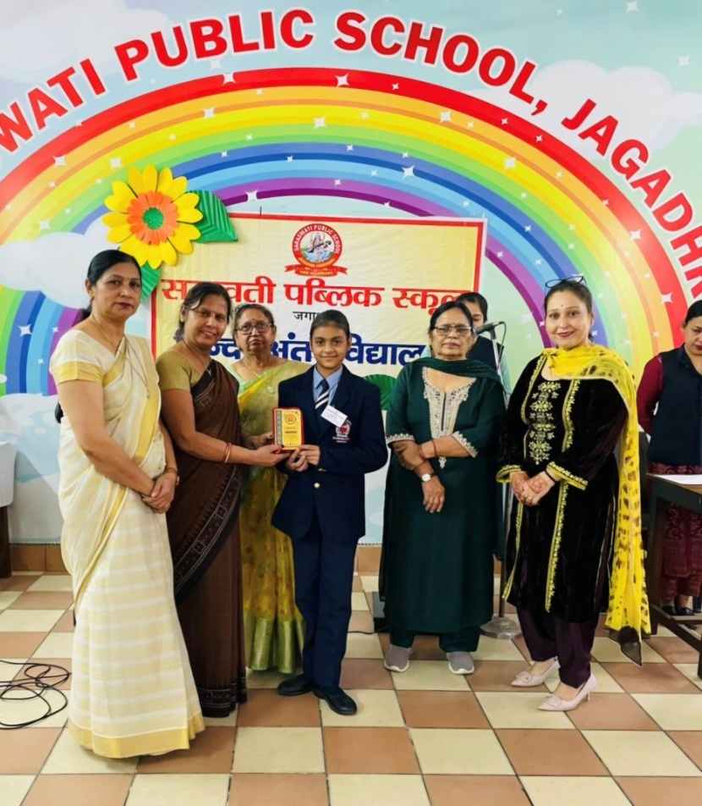
An Inter school Hindi Declamation Competition was held at Saraswati Public School, Jagadhri on 18th November 2025.
The results are as follows :-
Group A
Group B
Group C
Bhavi - First (Class 3 G)
Piyal – Consolation (Class 3 S)
Kanchan -First (Class 7 N)

Slide 16
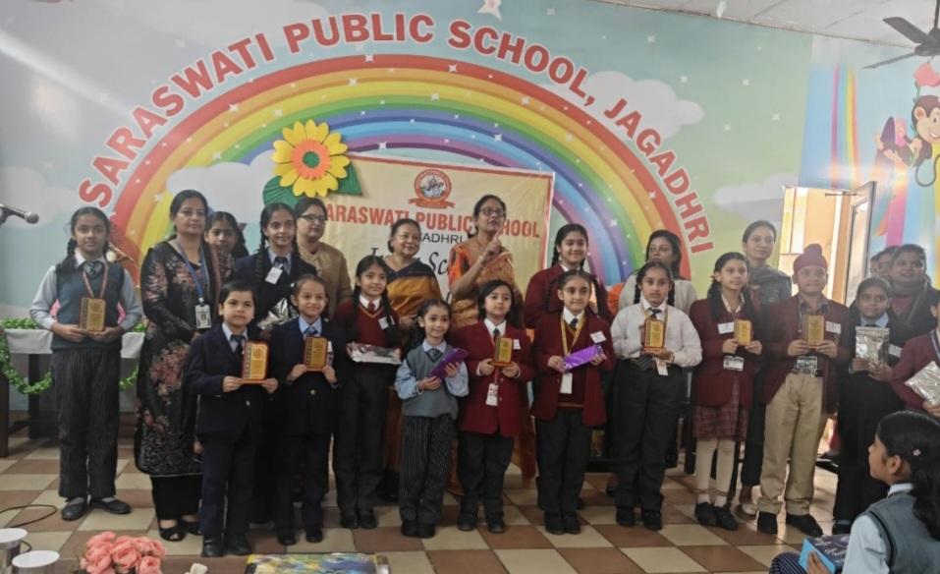
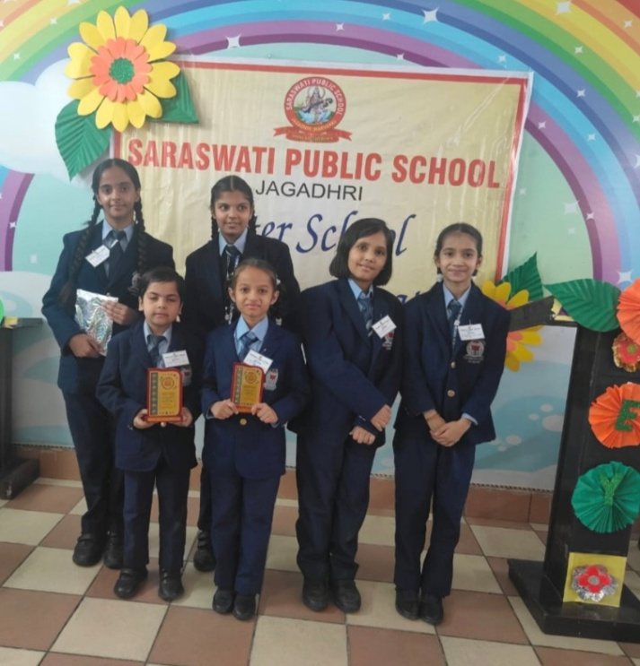
An Inter school English Declamation Competition was organized at Saraswati Public School, Jagadhri on 19th November 2025.
The results are as follows :-
GROUP A
Swatika - Ist Prize Amaira - 2nd Prize
Class 1 N Class 3 N
GROUP B
Avni – 3rd Prize
Class 7 N

Slide 17
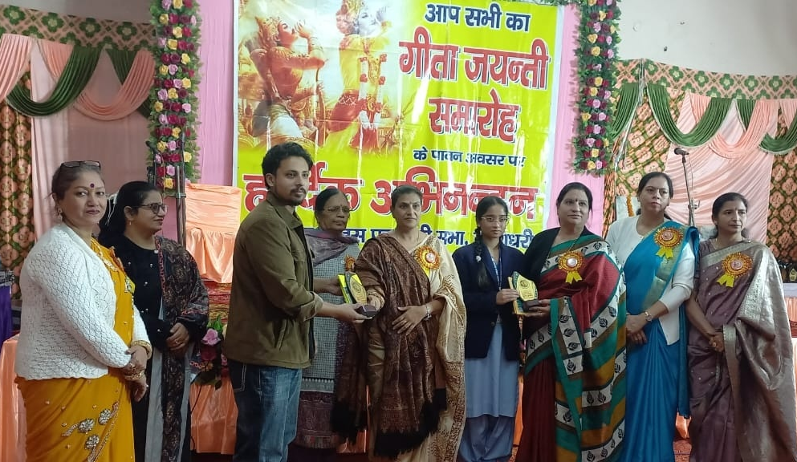
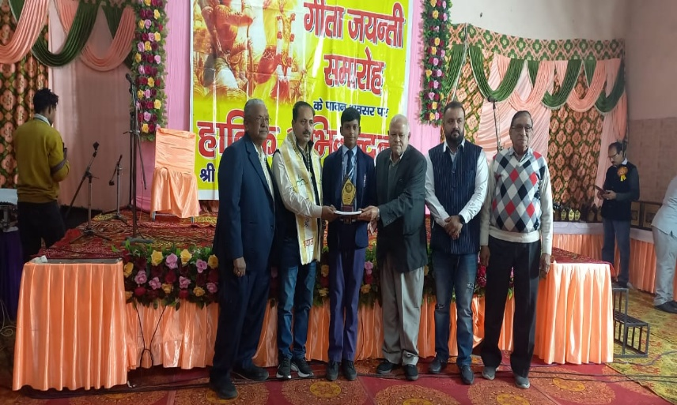
GEETA JAYANTI SAMAROH
On the occasion of Geeta Jayanti Samaroh at Ramleela Bhawan, Jagadhri different activities were conducted on 1st Decembe,r 2025 in which our students shone brightly by winning prizes .
The results are as follows:
Shravi (class IX) bagged first prize in written quiz competition.
Mannat(class XI) and nandini (class IX) won second prize in music.
Aayush (class IX) bagged second prize in painting.
Saanvi (class VII) won third prize in painting.

Slide 18
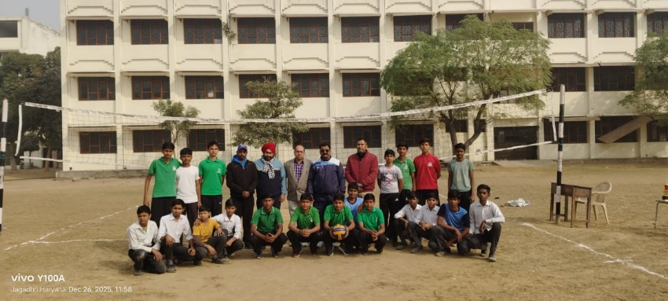
INTER SCHOOL VOLLEYBALL COMPETITION
Students of DSPS, Jagadhri participated in Inter school volleyball Competition held at S.D Senior Secondary School, Jagadhri on December 25, 2025.Our team proudly won the winner;s trophy match by 4-1.

Slide 19
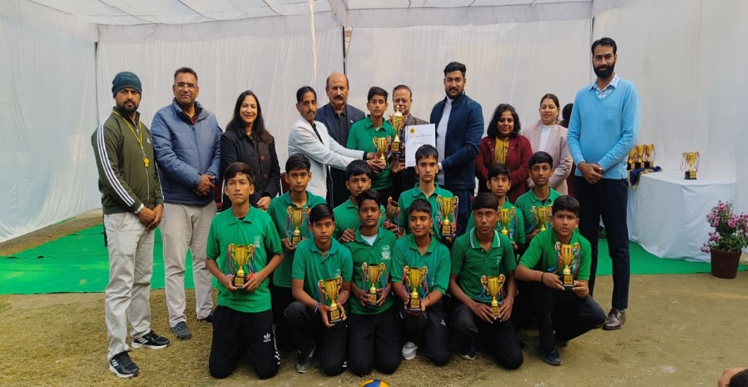
INTER DYAL SINGH VOLLEYBALL COMPETITION
Our school’s Under-14 Boys Volleyball Team participated in the Inter Dyal Singh Public School Volleyball Competition held at Dyal Singh Public School, Dyal Singh Colony, Karnal. The team delivered an excellent performance by defeating Dyal Singh Public School, Sector 7, Karnal and Dyal Singh Public School, Panipat, and successfully advanced to the finals.

Slide 20
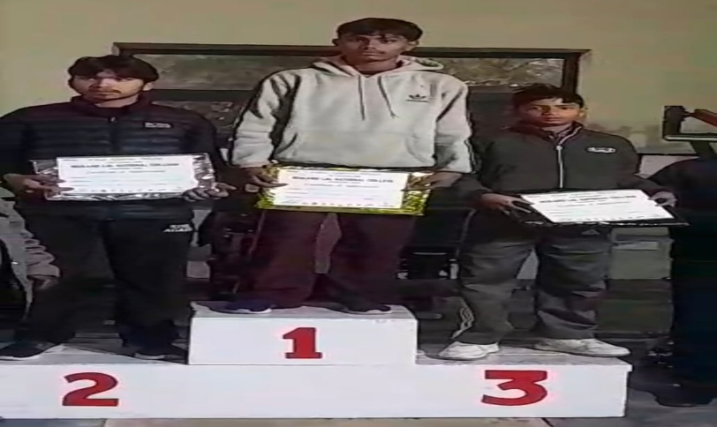
INTER SCHOOL DISTRICT LEVEL WEIGHT LIFTING COMPETITION
An Inter School District Level sports mela was held at Mukand lal national college, Yamuna Nagar on 23rd January in which Daksh of Class 6th secured 3rd Position in Weightlifting . He competed in the Under-14 age group, 35 kg category, showcasing remarkable strength, dedication, and determination. The event witnessed participation from various schools and colleges across the district.

